Slide 1

INVESTOR DECK · 2026
PourPlays
The Future of Wine Enjoyment
A gamified platform turning a $347B industry into the most engaging wine experience on the planet.
pourplays.com
Currently in beta

Slide 2
THE PROBLEM
PourPlays
The wine industry is stuck in a cellar.
Wine is one of the world's oldest cultural traditions — but it hasn't kept pace with modern audiences. Oversupply, declining consumption, price sensitivity, and broken promotions have left the industry scrambling.
01
Communication
02
Price opacity & poor promotions
Retailers and wineries rarely communicate with customers outside of a transaction. Small brands struggle to reach new buyers; shoppers stick to familiar labels.
Fragmented discounts, confusing loyalty offers, inconsistent regional pricing — shoppers can't find deals, brands can't measure them.
03
Scalability
04
Outdated experiences
Traditional, in-person tastings are limited in reach. The economics break before they begin.
Younger consumers expect interactive, gamified engagement. The wine industry gives them stuffy tasting notes and broken coupons.

Slide 3
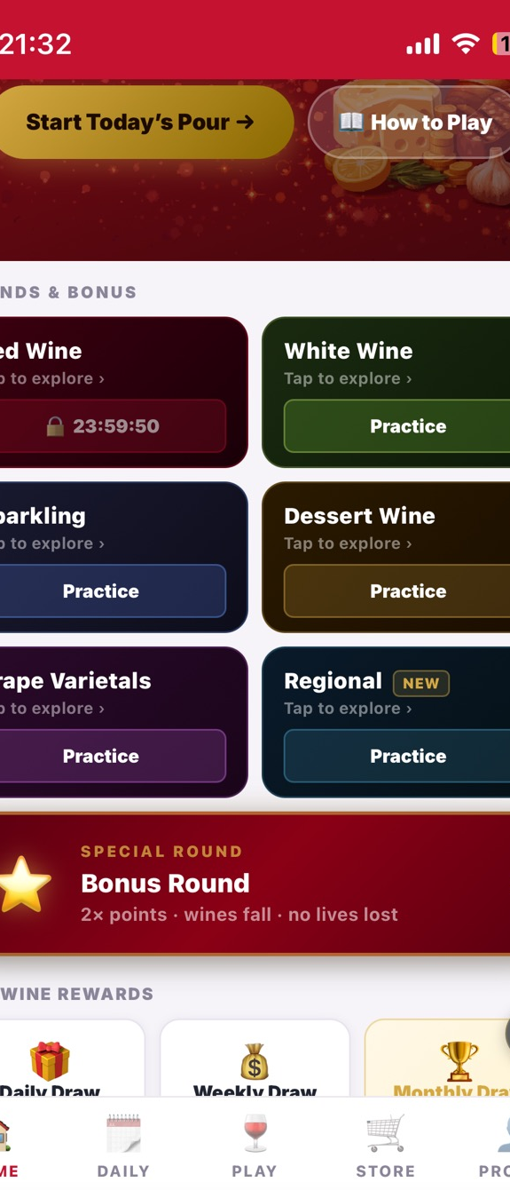
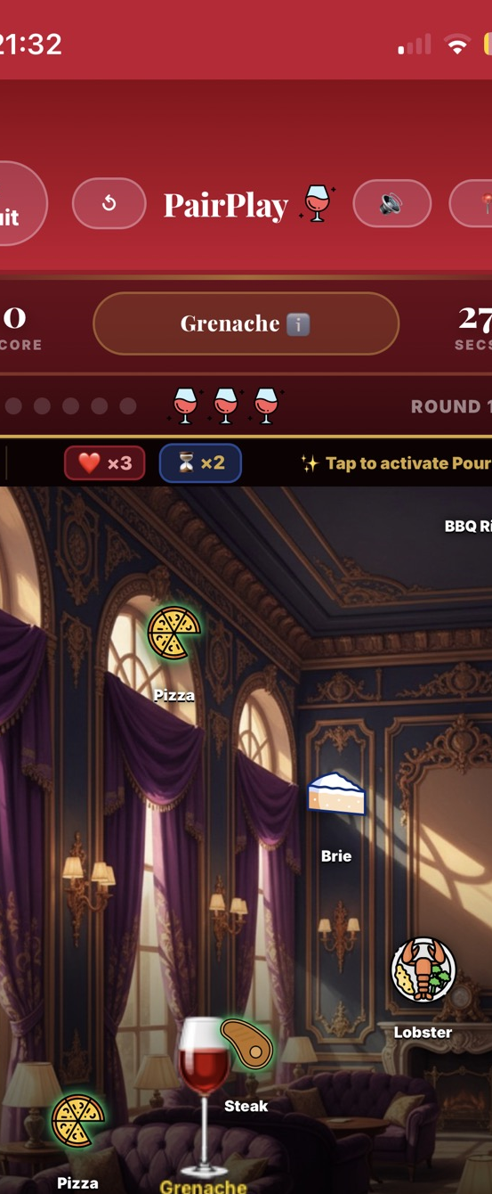
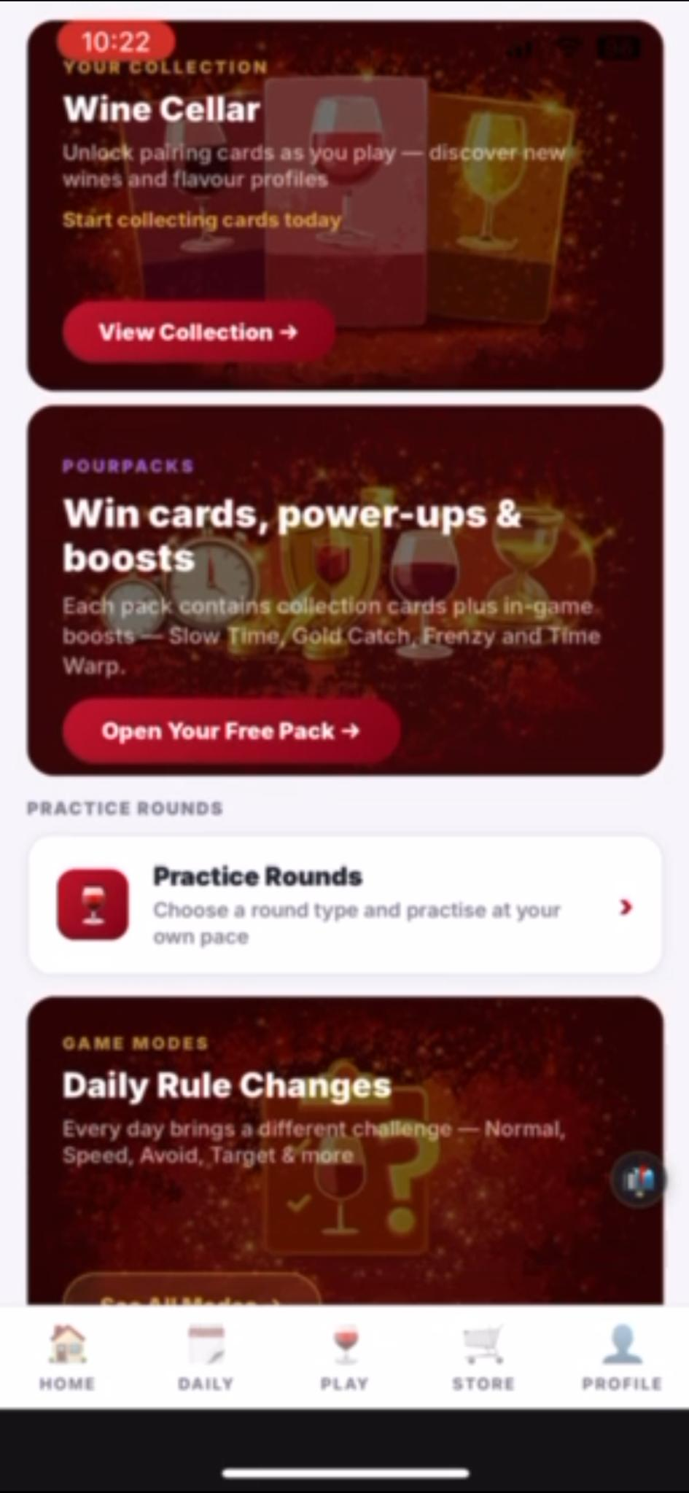
THE SOLUTION
PourPlays
Don't sell wine. Make wine a game.
PourPlays transforms wine discovery into an engaging, playful experience — gamified learning, curated coupons, live tastings, social connection, and real rewards.
Coupon AI
A centralized database of online and offline coupons tailored to each player's taste profile, redeemable at partner retailers.
Gamified Learning
From mobile games to live tastings, PourPlays keeps consumers engaged long after the first sip — unlocking coupons and rewards as they progress.
Social Connection
Wine becomes approachable and fun through shared experiences — game, gift, and share with friends inside the platform.

Slide 4
THE MODEL
PourPlays
A two-sided marketplace, gamified end-to-end.
PourPlays bridges two key groups in the wine ecosystem — delivering value to both simultaneously.
B2B
B2C
WINERIES & RETAILERS
WINE ENTHUSIASTS
Laithwaites · Total Wine · Wine.com · Wine Brands
Adults 25–55 · Free & premium memberships
→
Profile wineries & communicate directly with consumers
→
Play & Challenge — games, quizzes, mini-challenges
→
Issue Regular & Golden Coupons (up to 99% off)
→
Taste & Learn — live tastings, blogs, expert content
→
Conduct AI & live tastings
→
Earn & Connect — points, coupons, leaderboards
→
Gain first-party market insights & data
→
Centralized access to wine coupons & discounts
→
Targeted reach to wine-engaged, next-gen consumers
→
Free Freemium tier + Premium at $3/month

Slide 5
B2B — WINERIES
PourPlays
Winery engagement, reimagined.
Only a limited number of wine sites profile wineries. PourPlays gives wineries a direct channel to consumers — promotions, tastings, and market insights built into the game.
SAMPLE 30-DAY WINERY PROMOTION PACK (~$3K)
HOW PLAYERS UNLOCK COUPONS
1.
Complete a round → Regular coupon
30
Golden Bottles
Wine < $50 each
2.
Complete a Level → Golden Bottle coupon
Golden Cases
3.
Daily Leaderboard leader → Golden Bottle
4
Case of wine under $500
4.
Reach "Casual Drinker" status → Golden Case
1
Golden Subscription
5.
Weekly Leaderboard leader → Golden Case
Annual subscription — cases under $1,000
Progress to Enthusiast / Connoisseur / Sommelier / Master → Golden Subscription
6.
∞
Regular Coupons
Unlimited, X% off
7.
Monthly Leaderboard leader → Golden Subscription

Slide 6
B2C — CONSUMERS
PourPlays
A seamless journey into the world of wine.
Games, quizzes, roulette, mini-challenges — enabling players to expand their palate and explore new wines. PourPlays' first game, PairPlays, is a tetris-like food and wine pairing game. More games follow: PairPlays Slice, VitiVini.
PLAY & CHALLENGE
Live and virtual tastings, blogs, news, expert content — an interactive experience with cross-sell and upsell opportunities for wineries and retailers at every touchpoint.
TASTE & LEARN
Points, affiliate coupons, leaderboards, sharing, and social rooms — additional engagement touchpoints that keep consumers inside the PourPlays ecosystem.
EARN & CONNECT

Slide 7
B2C — MEMBERSHIP TIERS
PourPlays
Three tiers. One platform.
500K+ pipeline via Direct Wines partnership, social media marketing on LinkedIn, FB, Instagram & TikTok, daily free wine coupon giveaway pages, email database of 500K+ contacts. Target: 10% conversion on initial 500K = 50,000 premium members.
MEMBERS
Everyone who registers gets a Freemium account with immediate access to all available coupons, games, and learning tools. On PairPlays, no subscription fee applies — users unlock coupons through gameplay.
FREEMIUM
When ready to use coupons or convert earned points, users upgrade to Premium. PourPlays earns ~2% on affiliate wine sales. On the full PourPlays platform, consumers subscribe to Premium when they are ready to redeem.
PREMIUM — $3/month

Slide 8
REVENUE MODEL
PourPlays
Five revenue streams. Live from day one.
Streams 01–03 activate at PairPlays launch. Streams 04–05 unlock with the full PourPlays platform.
STREAM 01
2%
Affiliate Wine Sales
Commission on affiliate partner sales via Wine.com, Total Wine, Laithwaites, FlexOffers.
STREAM 02
$1/mo
In-Game Pack Sales
Average Freemium member spend on packs, power-ups, and extra lives inside PairPlays.
STREAM 03
$0.25/mo
In-Game Ad Revenue
Rewarded video ads — opt-in model, Freemium members only. No forced interruptions.
Premium Memberships
STREAM 04
$3/mo
$36/year. Unlocks coupons, advanced content, and premium prize draws. Activates with full PourPlays platform launch.
Other Revenue
STREAM 05
$1/mo
Per Premium member — Sponsorship, tastings, classes, gifting, merchandise, events, licensing & data insights.

Slide 9
MARKET OPPORTUNITY
PourPlays
Three giant markets. One white space.
PourPlays sits at the intersection of three massive, growing categories — and there is no incumbent.
$347B+
$250B
$110B
GLOBAL WINE MARKET
EDTECH MARKET
SOCIAL GAMING
Plus $23B+ in online wine retail in the U.S. alone. 40% of wine sold on discount — brands desperate for engagement.
Mobile-first learning is the fastest-growing segment. Our players are paying to learn.
Casual mobile gaming has eclipsed Hollywood. Daily-loop games dominate retention charts.
Whoever owns the daily wine ritual on mobile owns the next decade of this category.

Slide 10
MARKET OPPORTUNITY · GLOBAL TRENDS
PourPlays
Why the wine industry needs us now.
01
Premiumization
02
Declining consumption
Consumers are increasingly choosing higher-quality wines, a trend supported by e-commerce expansion and evolving tastes — creating an engaged, spendable audience.
Younger consumers prefer other beverages or low/no-alcohol options. The industry must meet them where they are — on their phones, through gamified discovery.
03
E-commerce growth
04
Gamification demand
Online wine sales continue gaining traction. Wine subscriptions are the fastest-growing DTC segment, creating natural integration points for PourPlays.
Interactive, gamified learning demand is rising across all verticals. PourPlays targets a proven, untapped white space in wine.

Slide 11
MARKET OPPORTUNITY · THE DISCOUNT DYNAMICS
PourPlays
40% of wine sells on discount. We fix that.
01
Oversupply
As of early 2025, the U.S. wine market has an inventory surplus, driving an increase in discounting. Brands need new distribution and engagement tools urgently.
02
Falling sales volume
With consumption volume declining, promotions have become the primary tactic — but they haven't reversed the trend. Engagement is the missing lever.
03
Price sensitivity
Younger consumers are more price-sensitive due to inflation. They are being pushed toward lower-priced bottles — making smart couponing essential.
04
Shift in consumer habits
Younger drinkers choose more affordable options or cut back entirely. Interactive, mobile-first discovery is how the category wins them back.

Slide 12
THE PRODUCT · PAIRPLAYS
PourPlays
Play. Learn. Win.
PourPlays' first mobile game — a food and wine pairing course disguised as a tetris-like game.
Players catch falling objects that pair well with foods, wines, and grape varietals — earning points and coupons along the way, building their wine knowledge, and progressing up the education ladder.
PLAY
Players start as Casual Drinkers and progress through 5 stages: Enthusiast → Connoisseur → Sommelier → Master. Each stage has 3 Levels (15 total). Each Level features 3 modes (Single Target, Normal, Avoid) with 7 Rounds each: Red, White, Dessert, Sparkling, Grape, Region & Bonus.
LEARN
Players win every time they log in and play. Each Round unlocks coupons and Wine Cellar cards. Daily, Weekly, and Monthly leaderboard leaders win Golden Coupons — bottles, cases, and subscriptions at up to 99% off.
WIN

Slide 13
TRACTION & PARTNERSHIPS
PourPlays
Live product. Live partnerships. Live wins.
AFFILIATE PROGRAMS
Laithwaites · Wine.com · Total Wine · FlexOffers — standard 2% rev-share affiliate programs operational at scale. PourPlays plugs into existing infrastructure on day one.
DIRECT WINES · 500,000 U.S. SUBSCRIBERS
Agreement to embed Laithwaites Wines on PairPlays. 500,000 U.S. subscribers will receive Freemium PourPlays accounts. Laithwaites will issue Regular and Golden Coupons through the game.
www.directwinesinc.com · www.laithwaites.com
INBOUND WINERY INTEREST
Adair Family Wines · Agajanian Vineyards · Domaine de Chevigneux · Domaine della · Paumanok Vineyards · The Wine Group — inbound interest from wineries and followers eager to engage next-gen consumers.

Slide 14

MEET THE TEAM
PourPlays
Byron Bennett
CEO & Founder
With over 20 years in the wine industry, Byron has served as founder of Discovery Wines in New York City, creator of the VitiVini wine board game, and author of Wine 101. His career spans credit analysis, investment banking, asset management, pharmaceuticals, consumer retail, fintech, and maritime transportation—experience that fuels practical innovation and disciplined strategic planning. Wharton School graduate.
Wharton Undergraduate Business School

Slide 15



MEET THE TEAM
PourPlays
Luis E. Rivera Cuyar
Noah Schwartz
Sunny Fraser M.S., LMHC
CTO
Content & Education Lead
Content & Education Lead
Founder of Riv Lux Media. Brooklyn-based creative technologist with 10+ years in digital media, photography, and cinematography. Worked with RED, CANON, SONY, PANASONIC, ARRI, and PANAVISION. Born in Puerto Rico, built in New York — brings a unique visual and technical edge to PourPlays.
Financial communications writer turned wine expert. Studied English at Vassar College, spent 10 years in London. WSET Level 4 Diploma (DipWSET) in 2017 — awarded The Amorim Scholarship for the highest U.S. WSET Level 3 score. Wine writer for Laithwaites, tastes 2,000+ wines annually.
Global wine, spirits & food communicator, consultant, and digital creator. Former winery owner and inventor of the award-winning Wine Tube. International competition judge (WIA Expert Judge). Creator behind @sunnyonscene. Background spans CEO roles, COO consulting, and licensed mental health counseling.
New York Film Academy · Universidad del Sagrado Corazón
DipWSET · Vassar College
M.S., LMHC · CEO / COO background
↗ linkedin.com/in/luisenriquerivera
↗ linkedin.com/in/noahschwartz
↗ linkedin.com/in/sunnyfraser
📷 @luisrivlux
📷 @laissezfare
📷 @sunnyonscene

Slide 16
PRODUCT ROADMAP
PourPlays
From MVP to global wine ritual.
Q2 2026
Q3 2026
2027
2028
MVP Polish & Seed Close
Launch & Partnerships
Content Scaling
Global Expansion
Embed in Direct Wines' 500K subscriber base. Launch first Laithwaites co-branded gameplay rounds. Go live with affiliate integrations.
Learn & Explore modules. Wine certification content (WSET). Social features — groups, leagues, friends. Premium engine push.
EU and APAC rollout. International partnerships. Full PourPlays platform with tastings, classes, gifting, and merchandise.
Lock $250K pre-seed. Stabilise iOS/Android wrappers. Onboard first Freemium players. Launch PairPlays beta.

Slide 17
THE ASK
PourPlays
$250K
PROJECTED PRETAX ROI
On $250K @ 20% equity, based on 3-yr P&L
for 20% equity
Pre-seed round. Closing now.
2026
1.8×
$1.8M return
USE OF FUNDS
MVP & Development
$100K
40%
iOS/Android shells, infrastructure, anti-cheat, payment integration
2027
12.8×
Marketing & Community
$12.8M return
$75K
30%
Launch campaign, content team, paid acquisition seed budget
$15K
Partnerships & Pilots
6%
Direct Wines launch, pilot integrations
2028
34.8×
$34.8M return
$60K
Operations & Team
24%
Legal, compliance, payroll runway

Slide 18
FINANCIALS
PourPlay — Three-Year Financial Projections
PourPlays
PourPlay — Financial Projections
2026 (Launch)
2027
2028
MEMBERS
Freemium Memberships
1,537,734
2,306,601
2,652,591
Premium Memberships (10% Conversion Rate)
153,773
230,660
265,259
REVENUES
Subscriptions @ $3/m — Premium Members
$461,319
$691,980
$795,777
Affiliate Wine Sales @ 2% on $20/m
$57,609
$86,414
$99,376
In-Game Pack Sales @ $1/m avg on Freemium
$738,867
$1,108,301
$1,274,546
In-Game Ad Revenue @ $0.25/m avg on Freemium
$184,717
$277,075
$318,636
Other Revenue @ $1/m Premium
$70,137
$105,205
$120,986
Total Revenues
$1,261,740
$2,268,975
$2,609,322
COST OF GOODS SOLD (COGS)
Payment Processor Fees (3%)
$37,852
$56,778
$62,456
App Store Fee (15% of in-app purchases)
$189,261
$283,892
$312,281
Total COGS
$227,113
$340,670
$374,737
Gross Profit
$1,034,627
$1,928,306
$2,234,585
OPERATING EXPENSES (SG&A)
Salaries Sub-total
$200,000
$600,000
$900,000
Development, Website, Partnerships & Maintenance
$187,500
$281,250
$323,438
Marketing & Advertising
$80,000
$120,000
$138,000
Prizes + Office + Legal + Insurance + T&E + Misc
$145,172
$217,508
$250,146
Total Operating Expenses
$613,672
$1,220,508
$1,613,584
BOTTOM LINE
Operating Income
$420,955
$707,798
$621,001
Net Profit (after 27% tax)
$366,955
$626,798
$527,851
EBITDA
$648,068
$1,048,468
$995,738

Slide 19

PourPlays
PourPlay is redefining how people discover and enjoy wine.
We are building the future of wine enjoyment — one that is gamified, social, and infinitely scalable.
Let's Build The Future Of Wine Enjoyment Together
Website:
https://pourplays.com/investors
Contact:
byron@pourplays.com

